Slide 1
RAC Software Installation

Slide 2
Objectives
After completing this lesson, you should be able to:
  Install and configure Automatic Storage Management (ASM)
  Install the Oracle database software
  Perform required tasks prior to database creation
Notes:
Oracle Database 11g: RAC Administration 2 - <number>

Slide 3
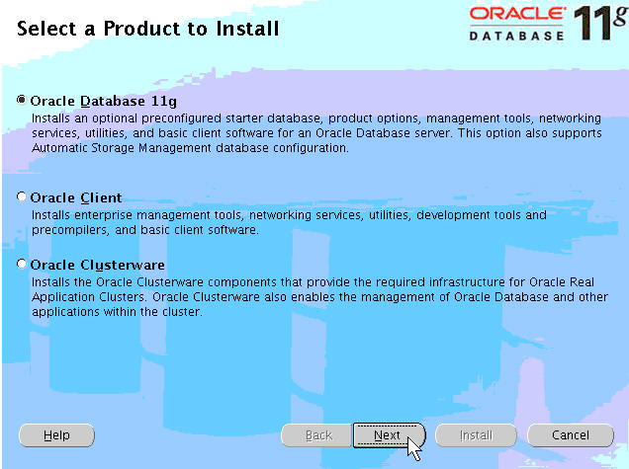
Installing Automatic Storage Management
$ id
oracle
$ /stage/db/runInstaller
Notes:
Installing Automatic Storage Management
For this installation, Automatic Storage Management (ASM) is used to manage the shared storage for the cluster database. After Oracle Clusterware is installed, run Oracle Universal Installer (OUI) from either the installation CD or a staged software location and install ASM as the oracle user.
$ id
oracle
$ cd /stage/db
$./runInstaller
The “Select a Product to Install” screen allows you to install and create a database, install Oracle client software, or install Oracle Clusterware. Click the Oracle Database 11g button and then click Next.

Slide 4
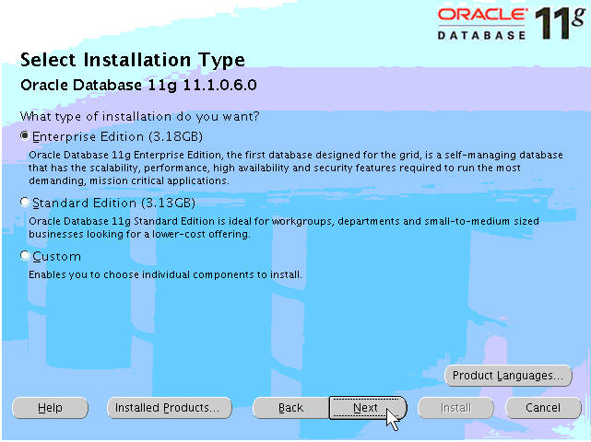
Installation Type
Notes:
Installation Type
When the Installation Type screen appears, select your installation type by clicking the Enterprise Edition option button. Click the Next button to proceed.

Slide 5
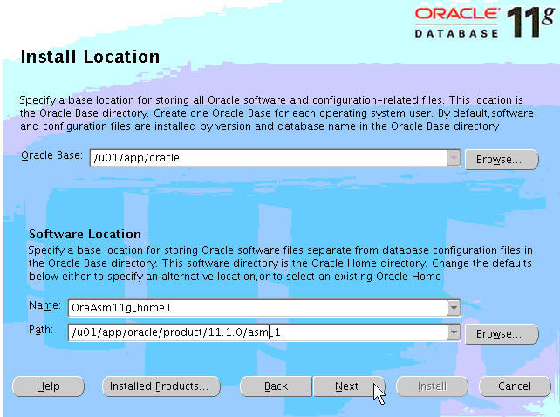
Install Location
Notes:
Install Location
The next screen that appears is the “Install Location” screen. Here you specify the location of your ASM home directory and installation name. Although it is possible for ASM and the database installation to reside in the same directory and use the same files, you are installing ASM separately, into its own ORACLE_HOME to prevent the database ORACLE_HOME from being a point of failure for the ASM disk groups and to prevent versioning difficulties between the ASM and database file installations. Be sure to specify a name for your installation that reflects this. Then click the Next button to continue.

Slide 6
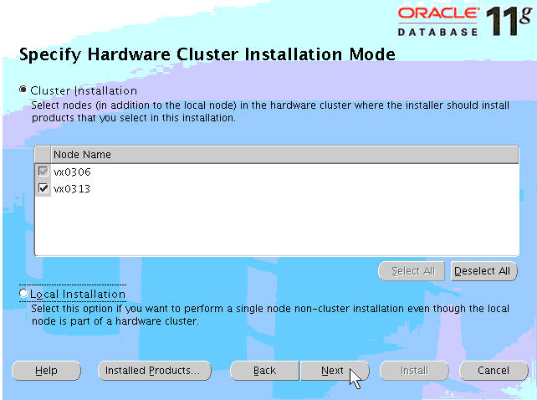
Hardware Cluster Installation Mode
Notes:
Hardware Cluster Installation Mode
When the Specify Hardware Cluster Installation Mode screen appears, click the Cluster Installation option button. Next, ensure that all nodes in your cluster are selected by clicking the Select All button. If OUI does not display the nodes properly, perform clusterware diagnostics by executing the olsnodes -v command from the ORA_CRS_HOME/bin directory, and analyze its output. Alternatively, you may use the cluvfy utility to troubleshoot your environment. Refer to your documentation if the detailed output indicates that your clusterware is not running properly.
When this is done, click the Next button to continue.

Slide 7
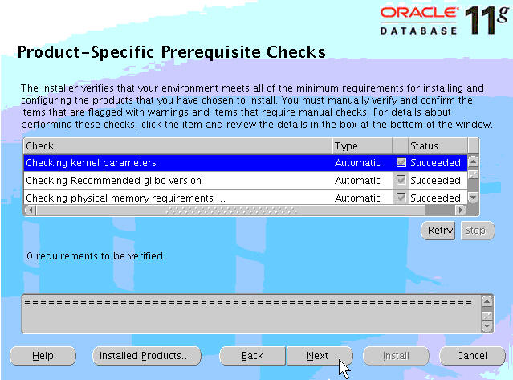
Product-Specific Prerequisite Checks
Notes:
Product-Specific Prerequisite Checks
The Product-Specific Prerequisite Checks screen verifies the operating system requirements that must be met for the installation to be successful. After each successful check, the Succeeded check box is selected for that test. The test suite results are displayed at the bottom of the screen. Any tests that fail are also reported here. The example in the slide shows the results of a completely successful test suite. If you encounter any failures, try opening another terminal window and correct the deficiency from another terminal window. Then return to OUI, and click the Retry button to rerun the tests. It is possible to bypass the errors that are flagged by selecting the check box next to the error, but this is not recommended unless you are absolutely sure that the reported error will not affect the installation. When all tests have succeeded, click the Next button to continue.

Slide 8
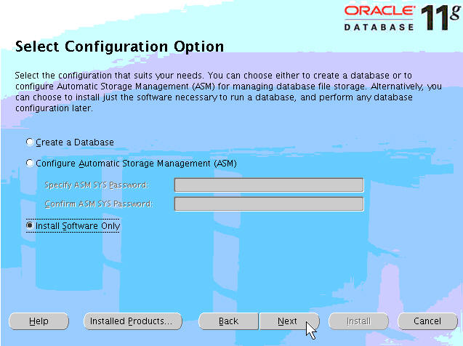
Select Configuration Option
Notes:
Select Configuration Option
The Select Configuration Option screen allows you to choose from the following options:
Install database software and create a database
Configure ASM
Install database software only (no database creation)
This installation is concerned only with installing the ASM Home, so click the Install Software Only button. When you have done this, click the Next button to proceed.

Slide 9
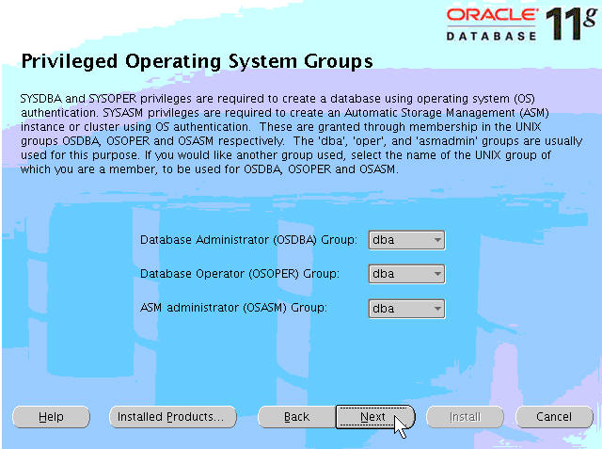
Privileged Operating System Groups
Notes:
Privileged Operating System Groups
On the Privileged Operating Systems Groups page, choose the operating system groups corresponding to the Database trusted groups listed to support OS authentication. The default value is dba for each group: OSDBA, OSOPER, and OSASM. Click Next to continue.

Slide 10
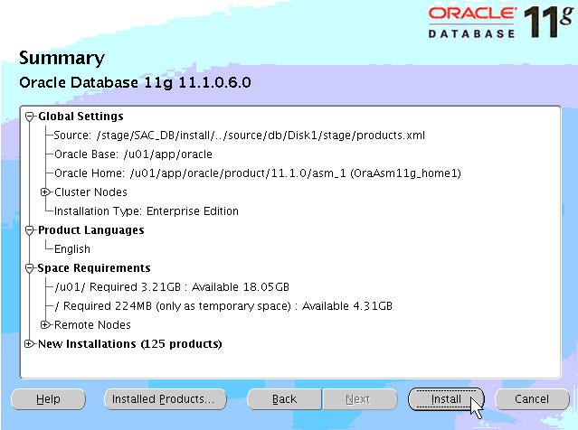
Summary
Notes:
Summary
The Summary screen appears next. You may scan the installation tree to verify your choices if you like. Then click the Install button to proceed.
You can monitor the progress of the installation on the Install screen. After installing the files and linking the executables on the first node, the installer copies the installation to the remaining nodes. When the installation progress reaches 100%, OUI prompts you to execute configuration scripts on all nodes.

Slide 11
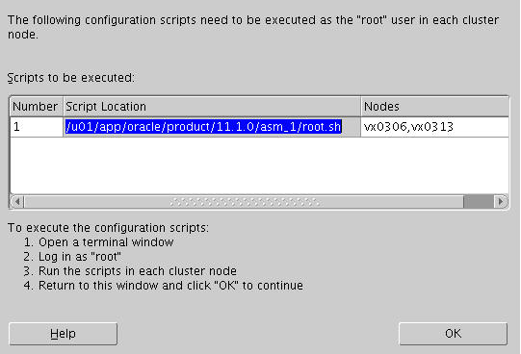
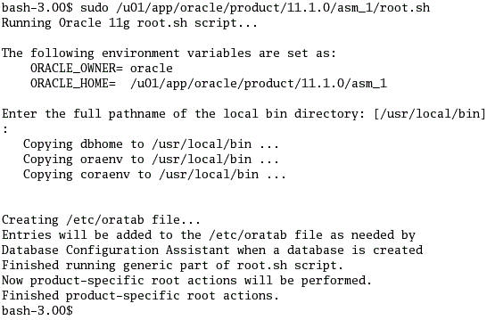
Execute Configuration Scripts
Notes:
Execute Configuration Scripts
The next screen that appears prompts you to run the root.sh script on the specified nodes. Open a terminal window for each node listed and run the root.sh script as the root user from the specified directory.

Slide 12
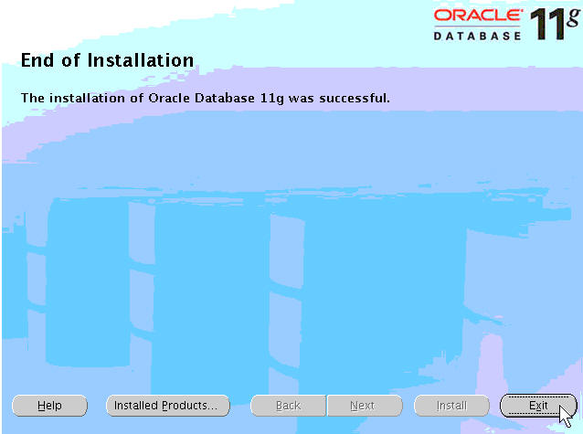
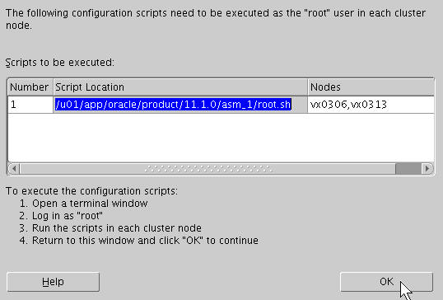
End of Installation
Notes:
End of Installation
When the root.sh script has been executed on all nodes in the cluster, return to the Execute Configuration scripts window and click the OK button to continue. When the installation is finished, the End of Installation screen appears. Click the Exit button to quit.

Slide 13
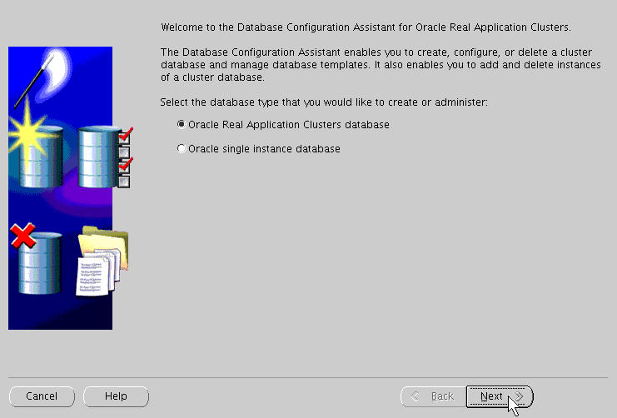
ASM Configuration
$ export ORACLE_HOME=/u01/app/oracle/product/11.1.0/asm_1
$ export PATH=$PATH:ORACLE_HOME/bin
$ dbca
Notes:
ASM Configuration
After the ASM software has been successfully installed, the ASM instances should be configured and started and disk groups should be created to support the shared storage needs of your cluster database. DBCA is used to do this quickly and accurately. Execute dbca from the ASM ORACLE_HOME/bin directory as shown in the slide. Select Oracle Real Application Clusters database from the Welcome screen and click Next.

Slide 14
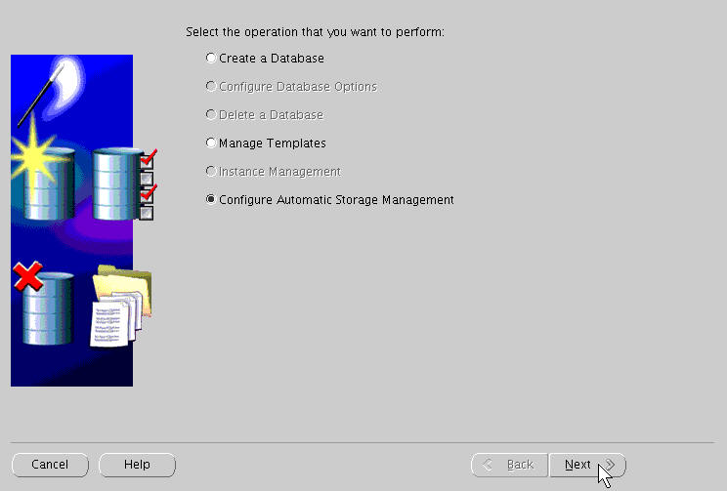
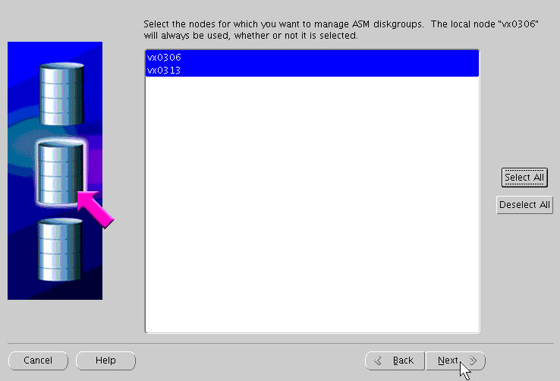
ASM Configuration
Notes:
ASM Configuration (continued)
On the next screen, click Configure Automatic Storage Management and click the Next button. You now choose the nodes on which to manage ASM. Click the Select All button, and then click Next to continue.

Slide 15
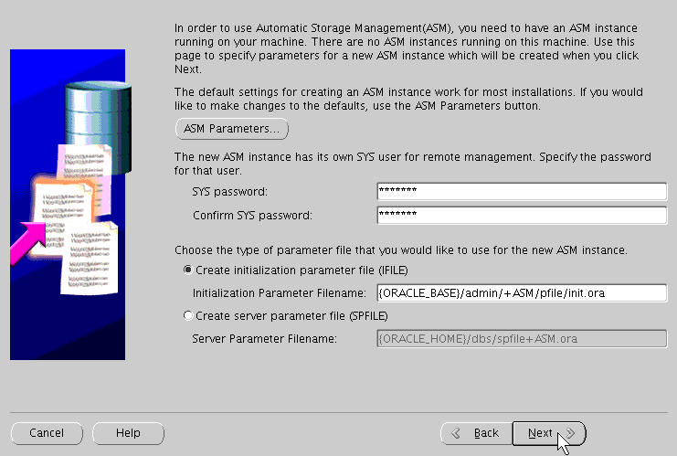
ASM Configuration
Notes:
ASM Configuration (continued)
At this stage, no ASM instances are running on your cluster nodes. Before starting the instances, you must provide a password for the ASM SYS user. In addition, choose the type and location of the parameter file to be used for the ASM instances. If you require specific initialization parameter values to be set for your ASM instances, you can modify the default values by clicking the ASM Parameters button. Then click Next to continue.

Slide 16
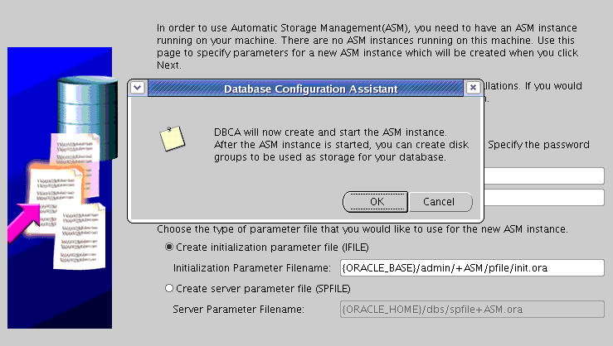
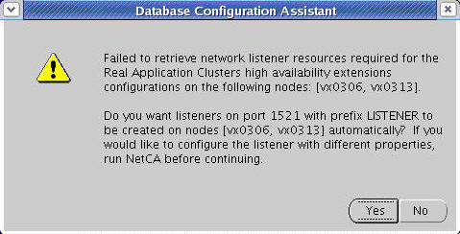
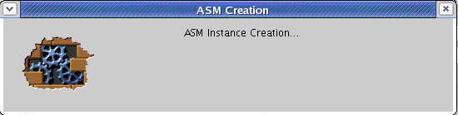
ASM Configuration
Notes:
ASM Configuration (continued)
A dialog box informs you that listeners are not running on the cluster nodes and asks if you want to start them now. When you click Yes to start the listeners, the ASM instances are started on the cluster nodes.

Slide 17
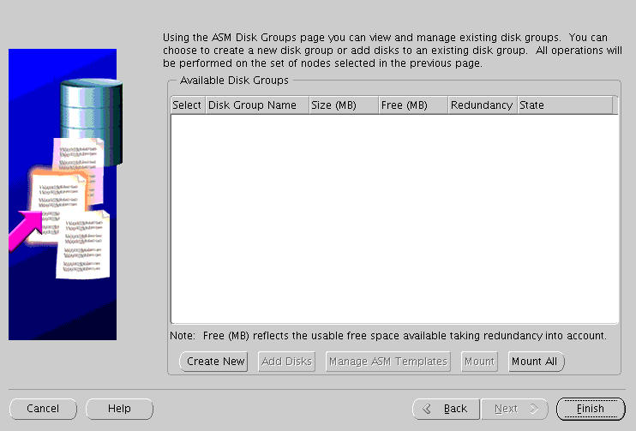
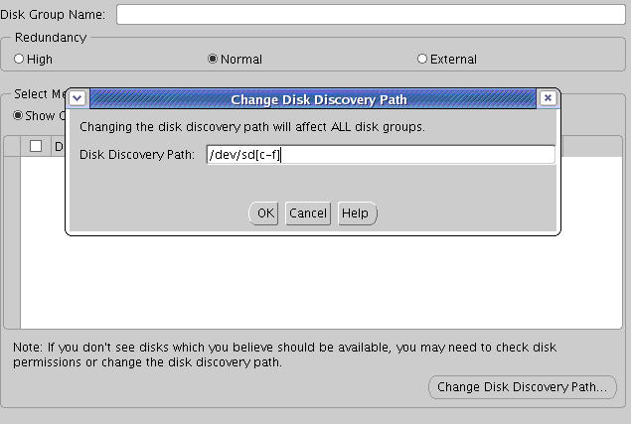
Creating ASM Disk Groups
Notes:
Creating ASM Disk Groups
When the instances are started, the ASM Disk Groups page is displayed. Click the Create New button to create a disk group. On the disk group creation page, click the Change Disk Discovery Path button to refine the search string that is used by DBCA to find candidate disk devices. Click the OK button after providing the discovery path to your disks.

Slide 18
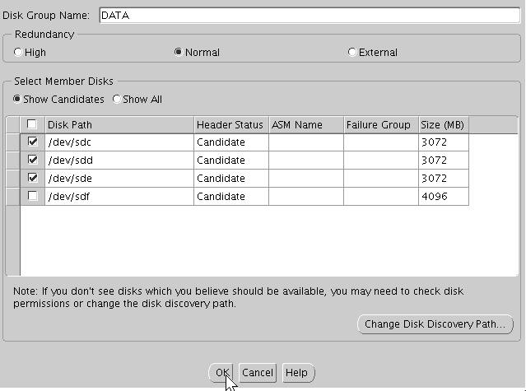
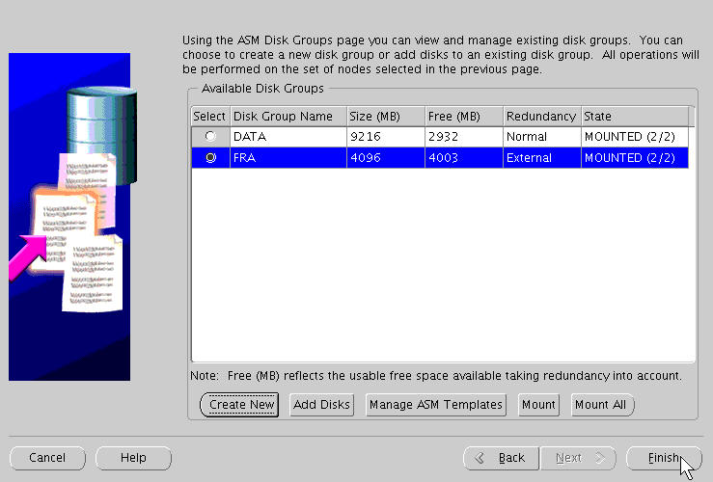
Creating ASM Disk Groups
Notes:
Creating ASM Disk Groups (continued)
A list of candidate disks and their relative size in megabytes is displayed. In the example in the slide, a DATA disk group is created using normal redundancy. When you click OK, the ASM disk group page is redisplayed showing the status of the newly created disk group. Other disk groups can also be created at this point.
When you have finished creating all the necessary disk groups, click Finish. A dialog box asks if you wish to perform other operations. Click No to exit DBCA.

Slide 19
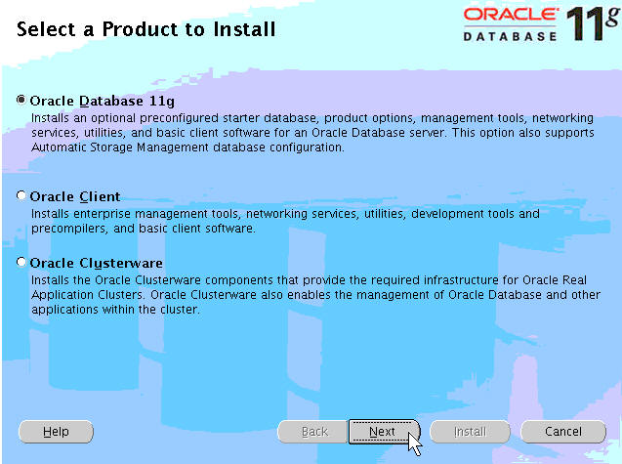
Select a Product to Install
$ /stage/db/runInstaller
Notes:
Select a Product to Install
The OUI is used to install the Oracle Database 11g software. You need to run OUI as the oracle user. Start OUI by executing the runInstaller command from the root directory of the Oracle Database 11g Release 1 CD-ROM or the software staging location. The “Select a Product to Install” screen allows you to install and create a database, install Oracle client software, or install Oracle Clusterware. Click the Oracle Database 11g button and click Next.

Slide 20
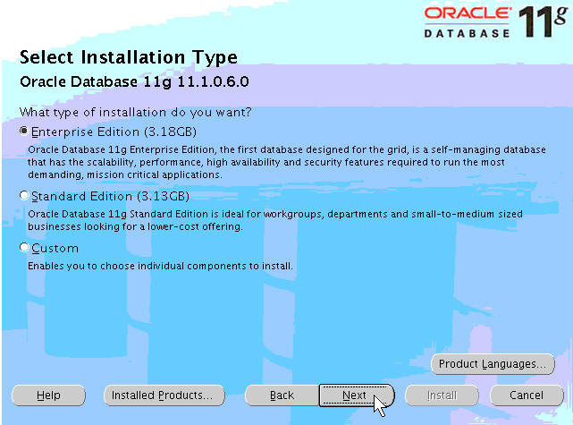
Select Installation Type
Notes:
Select Installation Type
The Select Installation Type screen is displayed next. Your installation options include:
Enterprise Edition
Standard Edition
Custom
For most installations, the Enterprise Edition installation is the correct choice (but Standard Edition is also supported). Selecting the Custom installation type option enables you to install only those Oracle product components that you deem necessary. For this, you must have a good knowledge of the installable Oracle components and of any dependencies or interactions that may exist between them. For this reason, it is recommended that you select the Enterprise Edition installation because it installs all components that are part of the Oracle Database 11g 11.1.0 distribution.

Slide 21
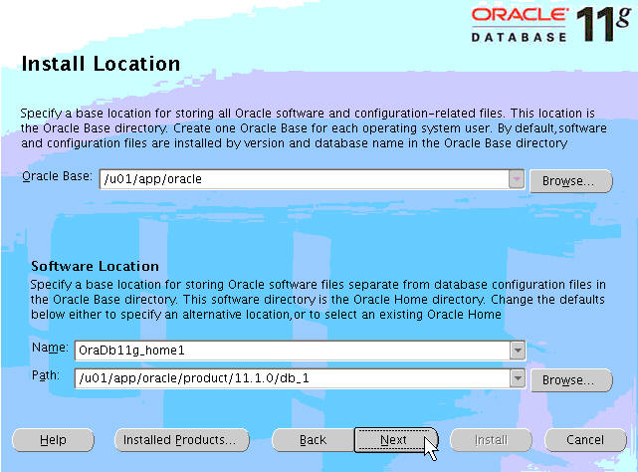
Install Location
Notes:
Install Location
On the Install Location screen, provide a value for ORACLE_BASE if you have not yet already done so. In the Software Location section of the page
The Name field is populated with a default or suggested installation name. Accept the suggested name or enter your own Oracle Home name. Next, in the Path field, enter the fully qualified path name for the installation, /u01/app/oracle/product/11.2.0/db_1 in the example in the slide. After entering the information, review it for accuracy, and click the Next button to continue.

Slide 22
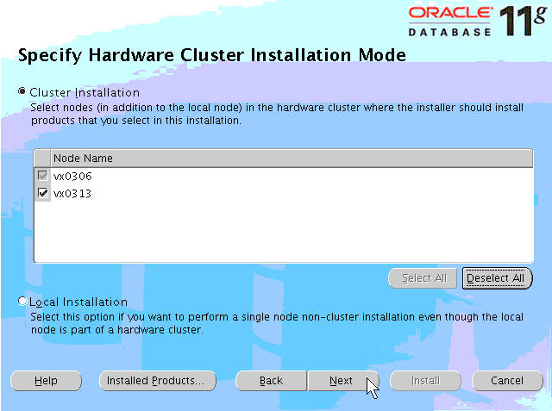
Specify Cluster Installation
Notes:
Specify Cluster Installation
The Specify Hardware Cluster Installation Mode screen is displayed next. Because OUI is node aware, you must indicate whether you want the installation to be copied to the recognized and selected nodes in your cluster, or whether you want a single, noncluster installation to take place. Most installation scenarios require the Cluster Installation option.
To do this, click the Cluster Installation option button and make sure that all nodes have been selected in Node Name list. Note that the local node is always selected for the installation. Additional nodes that are to be part of this installation must be selected by selecting the check boxes. If you do not see all your nodes listed here, exit OUI and make sure that Oracle Clusterware is running on all your nodes. Restart OUI. Click the Next button when you are ready to proceed with the installation.

Slide 23
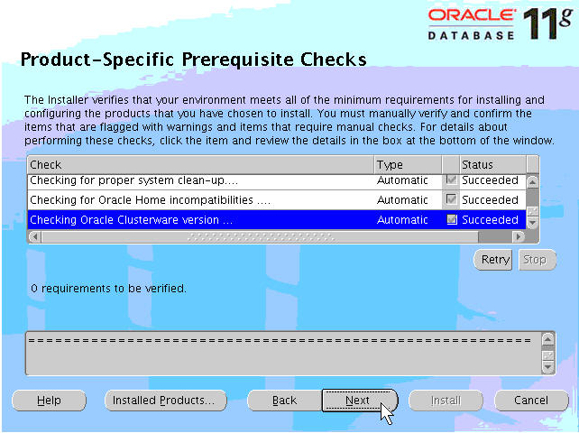
Products Prerequisite Check
Notes:
Products Prerequisite Check
The Product-Specific Prerequisite Checks screen verifies the operating system requirements that must be met for the installation to be successful. These requirements include:
Certified operating system check
Kernel parameters as required by the database software
Required operating system packages and correct revisions
Required glibc and glibc-compat (compatibility) package versions
In addition, OUI checks whether the ORACLE_BASE user environment variable has been set and, if so, whether the value is acceptable.
After each successful check, the Succeeded check box is selected for that test. The test suite results are displayed at the bottom of the page. Any tests that fail are also reported here. The example in the slide shows the results of a completely successful test suite. If you encounter any failures, try opening another terminal window and correct the deficiency. For example, if your glibc version is too low, acquire the correct version of the glibc RPM, install it from another terminal window, return to OUI, and click the Retry button to rerun the tests. When all tests have succeeded, click the Next button to continue.

Slide 24

Select Configuration Option
Notes:
Select Configuration Option
The Select Configuration Option screen appears. On this screen, you can choose to create a database as part of the database software installation or install ASM. If you choose to install a database, you must select one of the preconfigured starter database types:
General Purpose
Transaction Processing
Data Warehouse
Advanced (user customizable)
If you choose one of these options, you are queried about the specifics of your database (cluster database name, shared storage options, and so on). After OUI stops, the DBCA is launched to install your database with the information that you provided.
You may also choose to defer the database creation by clicking the Install Software Only option button. This option enables you to create the database by manually invoking the DBCA at some point in time after OUI finishes installing the database software. This choice provides you with more options than the standard preconfigured database models. Select the Install Software Only option. Click the Next button to continue.

Slide 25

Privileged Operating System Groups
Notes:
Privileged Operating System Groups
On the Privileged Operating Systems Groups page, choose the operating system groups corresponding to the Database trusted groups listed to support OS authentication. The default value is dba for the OSDBA, OSOPER, and OSASM groups respectively. Click Next to continue.

Slide 26
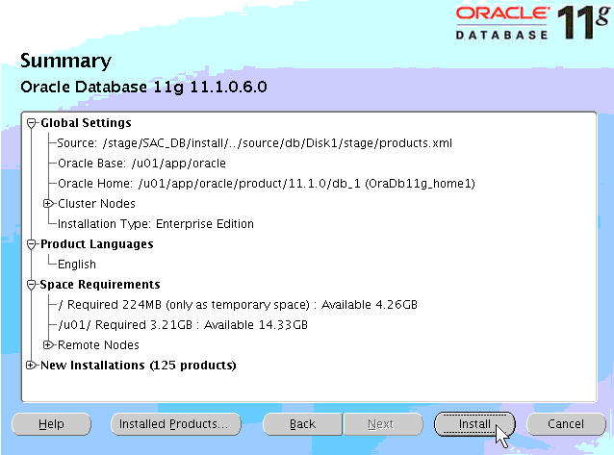
Check Summary
Notes:
Check Summary
The Summary screen is displayed next. Review the information on this page. Node information and space requirements can be viewed here, as well as selected software components. If you are satisfied with the summary, click the Install button to proceed. If you are not, click the Back button to go back and make the appropriate changes.
On the Install screen, you can monitor the progress of the installation. During installation, OUI copies the software first to the local node and then to the remote nodes.

Slide 27

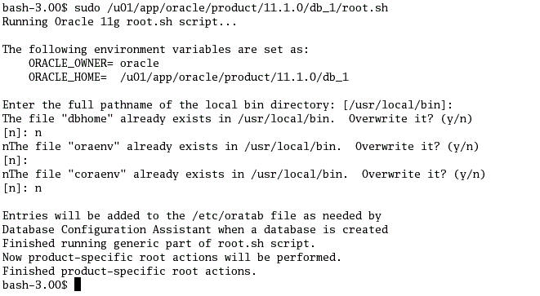
root.sh Script
Notes:
root.sh script
At the end of the installation, OUI displays a dialog box indicating that you must run the root.sh script as the root user on all the nodes where the software is being installed. Execute the root.sh script on one node at a time, and then click the OK button to continue.

Slide 28
Required Tasks Prior to Database Creation
Set the environment variables for the Oracle database:
$ cd
$ vi .bash_profile
export ORACLE_BASE=/u01/app/oracle
export ORACLE_SID=RDB1
export ORACLE_HOME=/u01/app/oracle/product/11.1.0/db_1;
export PATH=$PATH:$ORACLE_HOME/bin
Notes:
Required Tasks Prior to Database Creation
You can now set the Oracle database–related environment variables for the oracle user so that they are recognized by the DBCA during database creation:
$ cd
$ vi .bash_profile
export ORACLE_BASE=/u01/app/oracle
export ORACLE_SID=RDB1
export ORACLE_HOME=/u01/app/oracle/product/11.1.0/db_1
export PATH=$PATH:$ORACLE_HOME/bin

Slide 29
Checks Before Database Creation
  Use cluvfy to perform a configuration check before database creation.
  Use the –pre option with the dbcfg argument when executing runcluvfy.
  As oracle, run the command as shown below:
  Set the Oracle database–related environment variables for the oracle user.
$ cd /stage/db
$ ./runcluvfy.sh stage -pre dbcfg -n vx0306,vx0313 -d /u01/app/oracle/product/11.1.0
Notes:
Checks Before Database Creation
The Cluster Verify Utility can be used for the configuration check prior to database creation. Run the Cluster Verify Utility as the oracle user. Use the –pre option with the dbcfg argument to thoroughly analyze your cluster before creating your RAC database. Your output should be similar to the following example:
$ ./runcluvfy.sh stage -pre dbcfg -n vx0306,vx0313 -d /u01/app/oracle/product/11.1.0
Performing pre-checks for database configuration
Checking node reachability...
Node reachability check passed from node "vx0306".
Checking user equivalence...
User equivalence check passed for user "oracle".
Checking administrative privileges...
User existence check passed for "oracle".
Group existence check passed for "dba".
Membership check for user "oracle" in group "dba" [as Primary] passed.

Slide 30
Notes:
Checks Before Database Creation (continued)
Administrative privileges check passed.
Checking node connectivity...
Node connectivity check passed for subnet "138.2.204.0" with node(s) vx0313,vx0306.
Node connectivity check passed for subnet "10.0.0.0" with node(s) vx0313,vx0306.
Node connectivity check passed for subnet "192.168.255.0".
Suitable interfaces for VIP on subnet "138.2.204.0":
vx0313 eth0:138.2.204.33 eth0:138.2.205.171
vx0306 eth0:138.2.204.32 eth0:138.2.205.170
Suitable interfaces for the private interconnect on subnet "10.0.0.0":
vx0313 eth1:10.0.0.2
vx0306 eth1:10.0.0.1
Node connectivity check passed.
Checking CRS integrity...
Checking daemon liveness...
Liveness check passed for "CRS daemon".
Checking daemon liveness...
Liveness check passed for "CSS daemon".
Checking daemon liveness...
Liveness check passed for "EVM daemon".
Checking CRS health...
CRS health check passed.
CRS integrity check passed.
Pre-check for database configuration was successful.

Slide 31
Summary
In this lesson, you should have learned how to:
  Install and configure Automatic Storage Management (ASM)
  Install the Oracle database software
  Perform required tasks prior to database creation
Notes:
Oracle Database 11g: RAC Administration 2 - <number>

Slide 32
Practice 2: Overview
This practice covers the following topics:
  Installing and configuring ASM
  Installing the Oracle database software
Notes:
Oracle Database 11g: RAC Administration 2 - <number>

